Slide 1
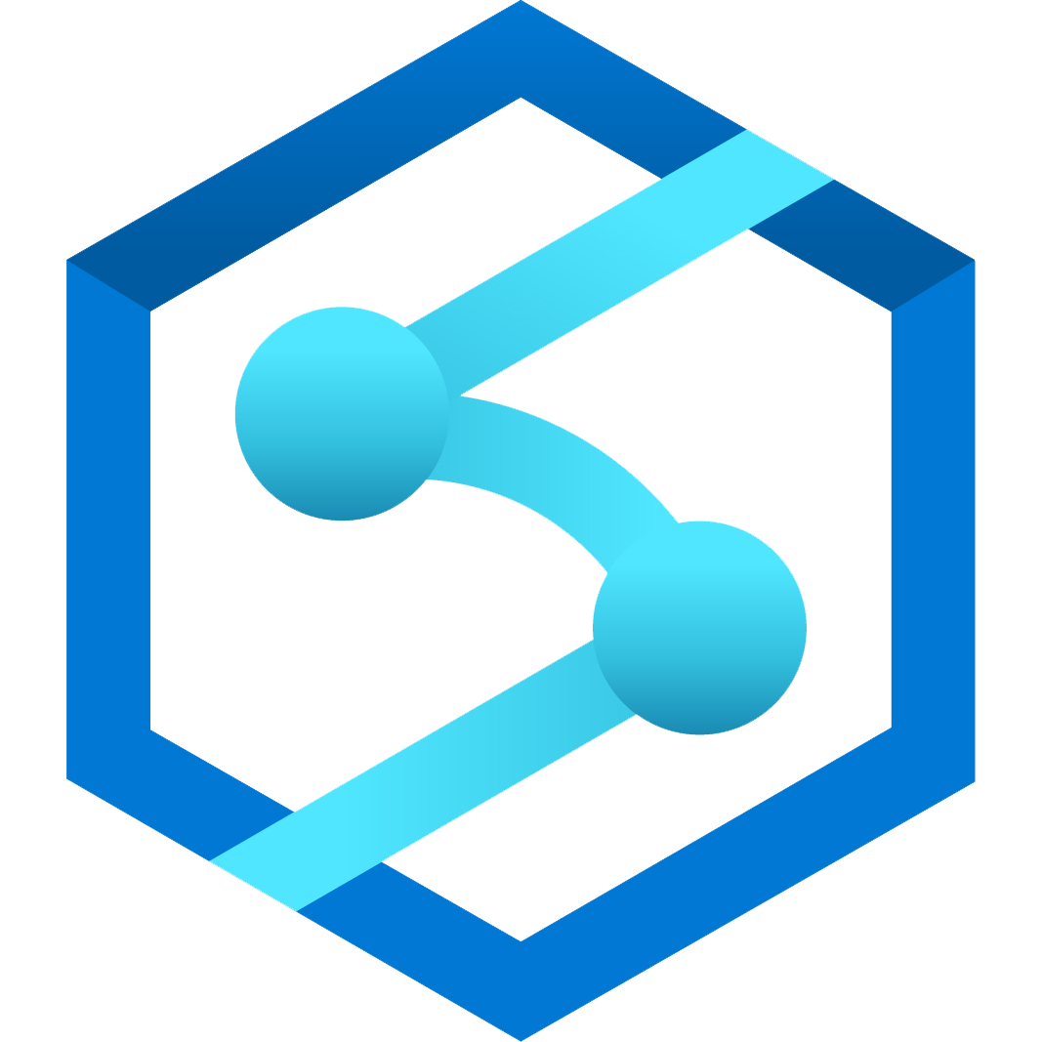


Accelerate mission value with a powerful analytics platform
Mission Value
Unmatched capabilities
Powerful visualization and reporting
Unified
analytics platform
Advanced analytics and AI
Frictionless collaboration
Mission analysts
IT professionals
Data scientists
Powerful and integrated tooling
Power BI
Azure Synapse Analytics
Azure Machine Learning
Unified data
Common Data Model on Azure Data Lake Storage

Slide 2




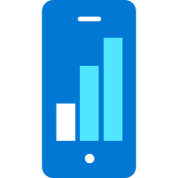

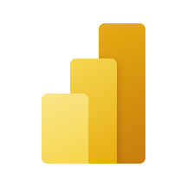

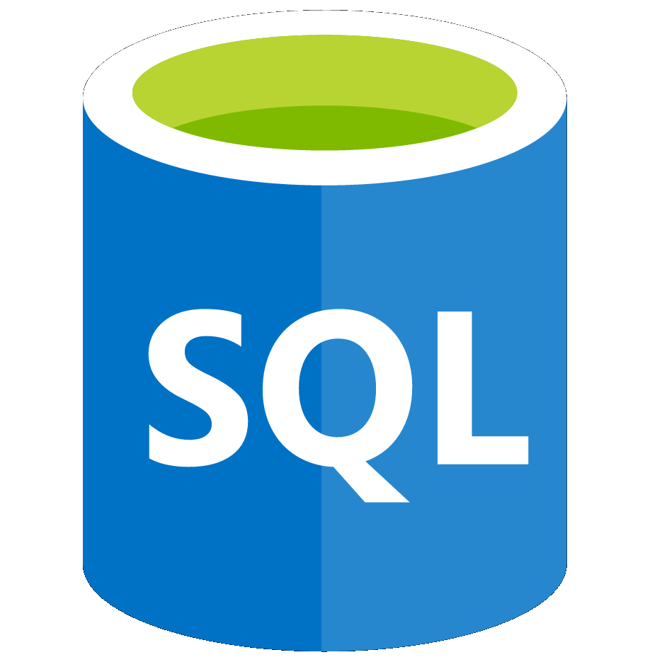
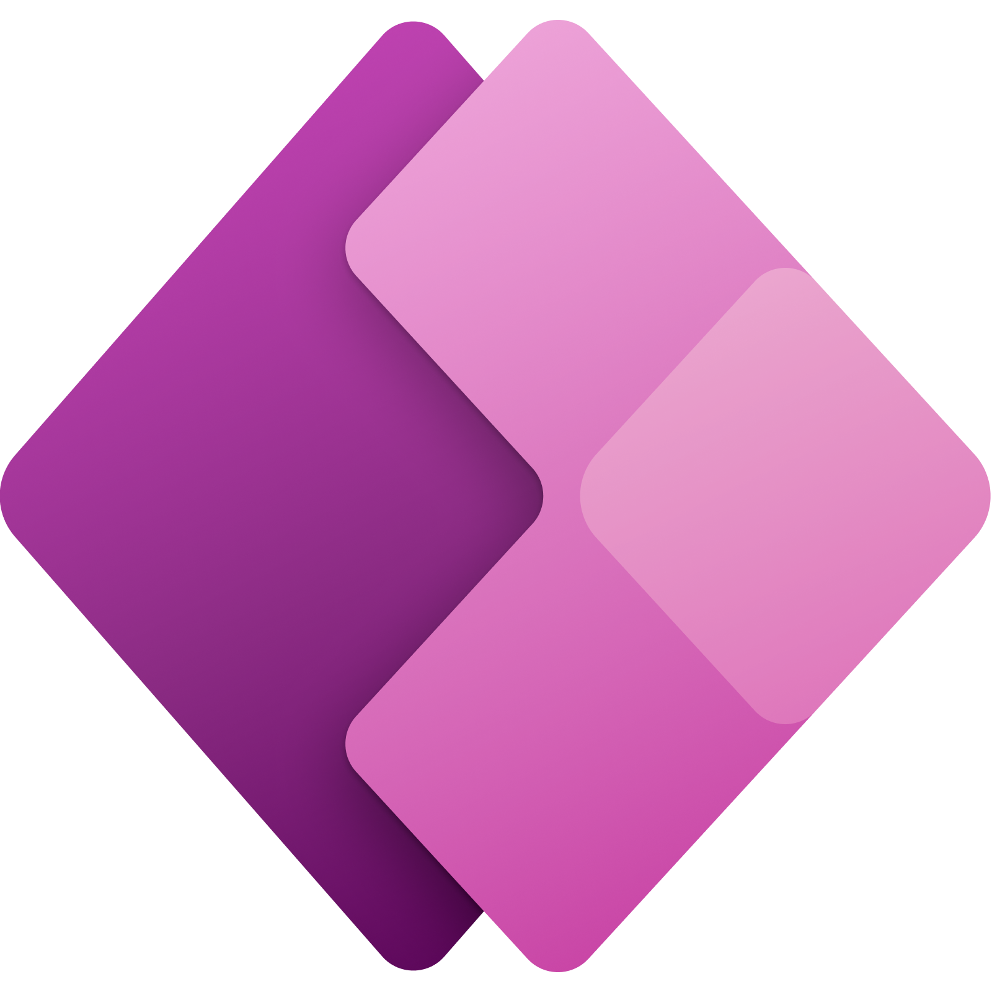
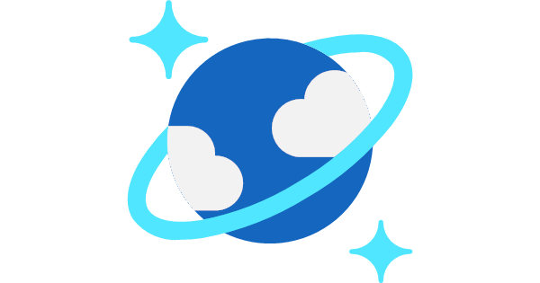


Azure Synapse Analytics
cloud-native analytics platform
Designed for analytics workloads at any scale
SaaS developer experiences for code free and code first
Multiple languages suited to different analytics workloads
Integrated analytics runtimes available dedicated and serverless on-demand
SQL Analytics offering T-SQL for batch, streaming and interactive processing
Spark for big data processing with Python, Scala, R and .NET
Integrated platform services for, management, security, monitoring, and metastore
Data lake integrated and Common Data Model aware
On-prem data
Azure Synapse Studio
Azure
Data Share
Integration
Database Templates
Management
Monitoring
Security
DevOps
Cloud data
Analytic runtimes
Azure
Machine Learning
SQL
Data Explorer
SaaS data
Semantic Layer – Common Data Model
Data Warehouse
Data Lake
Event Brokers
Azure Synapse Link
Power BI
Streaming data
Cosmos DB
Dataverse
Power Apps
Azure
Purview
Notes:
Azure Synapse unifies your data, your data tasks, and your data teams with a limitless analytics service that does it all. This is the result of a multi-year effort.
We set out to rearchitect and create the next generation of query processing and data management with Synapse to meet the needs of the modern, high scale, volume, velocity, and variety of data workloads.
As these modern workloads require both SQL and Apache Spark, we saw that customers would need a cloud-native analytics service engine that converged big data and data warehousing so they could achieve limitless scale on structured, semi-structured, and un-structured data.
Kim

Slide 3
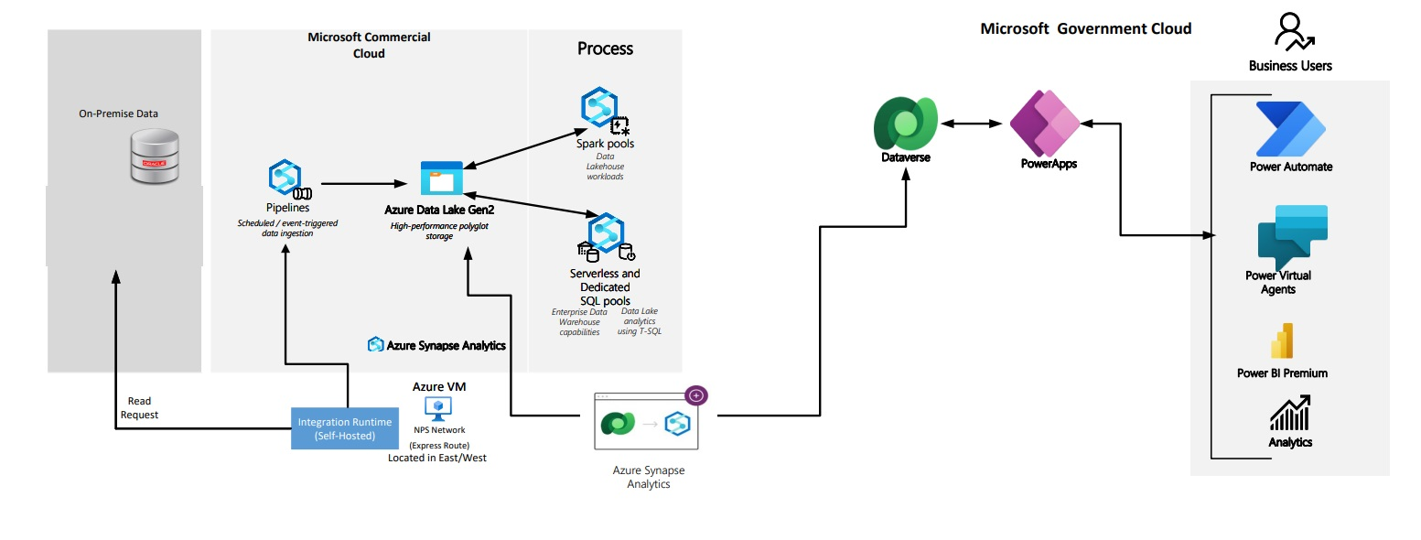
National Park Services: Better Together Solution
Real-world GCC Azure + Biz Apps solution for National Park Services
Enabling more Azure integrations in GCC will let us drive more of these solutions that other cloud vendors cannot compete with us on
Notes:
A great example

